Slide 1

Web Summarizer
COSC 4P02 FINAL PROJECT
Brock University
Team members
Thomas Van Veen – Product Owner
Yuvraj Sehgal – Scrum Master
Antonio Belsito
Duc Nguyen Minh
Ralph Terte

Slide 2

Goals of Web Summarizer
The goal of our software is to summarize the given texts, or the content of the webpage provided as a web-link.
It helps customers to explore various LLMs to extract precise summaries so that they can save time

Slide 3

Brief description
Summarization features
Multiple LLMs available for users
Bart – unpaid
Open AI – paid (Pro)
Summary of text (up to 5000 characters in one input)
Summary from URL (reads all the paragraphs and feeds the LLM using HTML parsers)
Shortened Sharable links to share your chat summaries with your friends and colleagues (Pro)
Explore your past histories and share them at anytime (Pro)

Slide 4

Brief description
User Management features
New User registration
Login/Logout
Password reset
Faster login using oAuth 2.0 – Google/Git-hub Login
Protected by JWT authentication
Encrypted data in DB for robust security

Slide 5

Brief description
UI/UX features
Easy to navigate
Super user-friendly interface
Dark-mode
Fast and reliable communication between FE and BE
Thousands of small features to make user experience better – like copy summary, share links etc.
Almost 0 exposure of any BE end-points for better experience and security

Slide 6
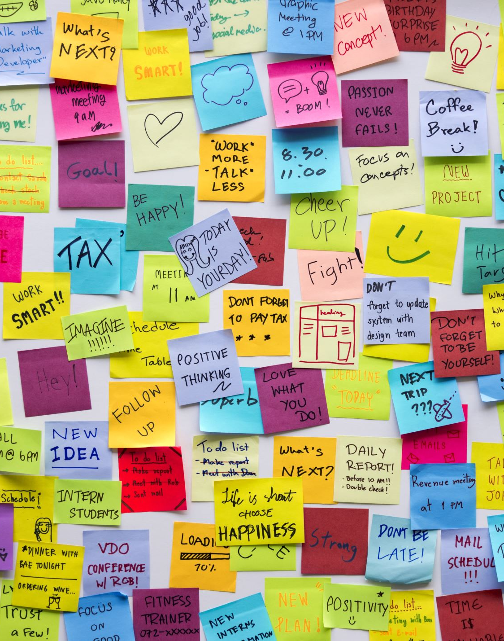
Development Procedures
Dynamic Project – So we decided to use agile methodology scrum
Benefits of using agile scrum:
Lot of changes during development phases
Bart shut down
Changes in security
Pro features changes
Oauth 2.0 implementation

Slide 7

Sprints
Overall, we finished our application in 5 sprints
Initial sprints lengths were 2 week -> later changed to 3 weeks
Daily scrums – (3-4 times a week)
First sprint – discussed basic layout, design, must have features of the application, setup JIRA board, product backlogs, scrum meetings setup, tech stack setup
Further sprint led to the development of new features of the application
After each sprint we got the opportunity to improve our teamwork and overall productivity
Also adapted some Xtreme programming techniques such as peer review

Slide 8

Sprints – How we practiced agile
Adjusted the number of story points accordingly – during the exam time
Minimal Documentation – only necessary like Security layers, request flow
Used Automated testing tools and frameworks such as Junit
Incremental development – Before first presentation MVP was ready

Slide 9

Tools
The tools used for development and Scrum includes:
JIRA – for scrum management
Plugins such as agile box for retrospectives
Confluence for documentation of architecture, UML and ER diagrams
IntelliJ, Visual Studio PgAdmin, Postman for development

Slide 10
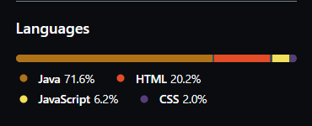
Tech stack
Backend
Java Spring boot
PostgreSQL
Junit – 5
Front-end
Thyme leaf (gets along with java)
JavaScript
HTML/CSS

Slide 11
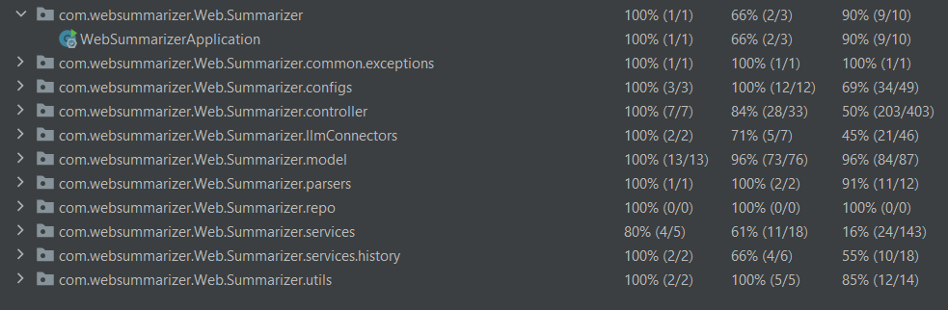

Testing – Unit Testing/IST
Unit testing done by the developers of the class/entity
A little behind the expected coverage:
Reason: most of the untested lines belongs to FE (Web Controller to redirect users to correct endpoints)
Difficult to test RSA Key generators/Oauth Logins Requests/Token Generators
Also used some AI plugins in unit testing
IST done manually

Slide 12
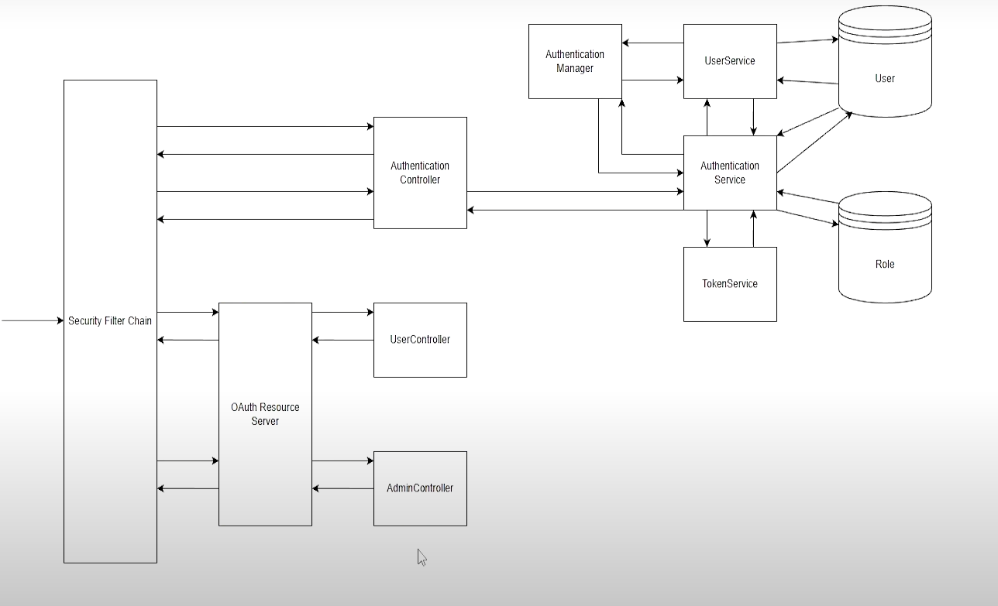
Software Security Structure
Open endpoints – login/signup/free summarization
Secured endpoints – requires valid JWT Authorization
All requests
Filter chain
Auth layer
Auth service
User service
User repo (DB)

Slide 13
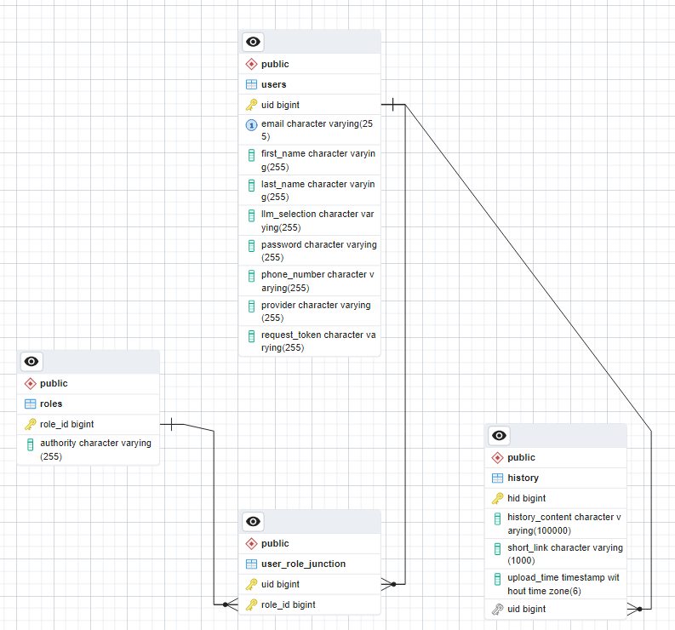
Software Database

Slide 14
Future work
Advanced features:
Video/Audio Summarization
Increased length of input texts for pro users
More paid features such as customized LLM system inputs
For better summarization: “Summarize the given text for a 10-year-old kid”

Slide 15
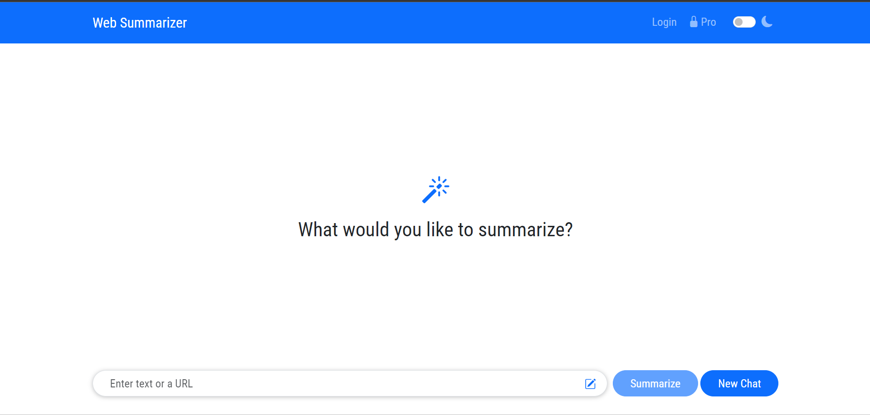
Demo Time

